Slide 1

AMRUTVAHINI COLLEGE OF ENGINEERING,
SANGAMNER
DEPARTMENT OF COMPUTER ENGINEERING
2024-2025
Presentation
On
“BlockShare - Blockchain Based Secure Data Sharing Platform”
BE Computer Engineering
BY
Group Id- B-06
Mr. Abhijit Rajaram Sahane (4228)
Mr. Shinde Rohit Nivrutti (4240)
Mr. Sayyad Mohammadsaani Shahid (4234)
Guided by: Project Coordinator: H.O.D
Ms. K. U. Rahane Dr. D. R. Patil / Dr. R. G. Tambe Dr. S. K. Sonkar

Slide 2
Abstract
In today’s digital world, data is incredibly valuable, and sharing it securely is more important than ever. However, centralized platforms that are commonly used for data sharing come with issues like privacy concerns, security risks, data breaches, data loss, and a lack of control over who accesses the data. These platforms also often rely on third parties like centralized servers and databases, making data vulnerable to misuse or breaches. To address these issues, our platform uses the core concepts of blockchain, such as decentralized storage and peer-to-peer communication.

Slide 3
BlockShare Blockchain based data sharing platform
In today’s world data is a new fuel which drives the industries and there operations. From personal information to important business data, sharing data safely and easily is crucial for everyone including individuals, businesses, governments, and communities that depend on accurate, trustworthy information. But sharing data privately and securely remains difficult, especially with traditional, centralized platforms. This project aims to solve these problems by creating a secure, private, and efficient data-sharing platform that is different from traditional models. By using ideas from blockchain, decentralized storage, and peer-to-peer (P2P) communication, our platform removes the need for central authorities.

Slide 4
Literature Review
Sr. No. | Author & Year | Title | Findings and Algorithm
1 | Pengyong Cao , Guijiang Duan, Jianping Tu Qimei Jiang Xianggui Yang, Chen Li, 2023 | Blockchain-Empowered Trustworthy Data Sharing Fundamentals, Applications, and Challenges | It surveys blockchain-based architectures and applications. Explores the fundamentals of blockchain technology.
2 | Rui Song , Bin Xiao , Senior Member, Yubo Song , Songtao Guo ,and Yuanyuan Yang, 2023 | A Survey of Blockchain-Based Schemes for Data Sharing and Exchange | Examines access control mechanisms. Discusses interoperability challenges.
3 | Pengyong Cao, Guijiang Duan, Jianping Tu Qimei, Jiang Xianggui Yang and chen li, 2023 | Blockchain-Based Process Quality Data Sharing Platform for Aviation Suppliers | The paper outlines a blockchain-based platform for process quality data sharing. The platform is designed specifically for aviation suppliers.
4 | Vikas Jaiman and Visara Urovi 2020 | A Consent Model for Blockchain-Based Health Data Sharing Platforms | It presents a dynamic consent model using blockchain technology. The model enables secure and accountable health data sharing.

Slide 5
Literature Review
Sr. No. | Author & Year | Title | Findings and Algorithm
5 | M. Yang and Y. Yang, 2014 | Applying Network Coding to Peer-to-Peer File Sharing. | Peer-to-Peer File Sharing. Peer-to-peer Network.
6 | Yi Lu, Weichao Wang, Bharat Bhargava, and Dongyan Xu | Trust-Based Privacy Preservation for Peer-to-Peer Data Sharing | Preserving privacy in P2P network.
7 | Fahad Ahmad Al-Zahrani, 2020 | Subscription-Based Data-Sharing Model Using Blockchain and Data as a Service | It utilizes the Data as a Service (DaaS) framework. Incorporates flexible pricing mechanisms.

Slide 6
Objectives
To understand the basics of blockchain and how blockchain works.
To understand the security concepts related with blockchain.
To implement Peer-to-peer communication to share the data.
To create a decentralized system to eliminate the need for a central authority.
To develop a secure data sharing platform utilizing concepts of blockchain technology.

Slide 7
Feasibility
Technical Feasibility:
Blockchain Technology.
Scalability Solutions.
Integration with Existing Systems.
Economic Feasibility:
Cost-Benefit Analysis.
Market Demand.

Slide 8
Scope Of The Project
Secure user authentication.
Connect users via P2P network.
Secure data sharing.
Audit trails.

Slide 9
Software requirements
Operating System - Windows 7/8/10 / Linux / Mac.
Frontend Frameworks - React.js ,Tailwind CSS.
Backend Frameworks – Node.js, Express.js.
File Storage – IPFS File Storage.
API - e.g. Rest API.
Programming Languages - JavaScript.

Slide 10
Hardware requirements
Ram : 8GB
Rom : 256 GB SSD
Processor : 3.0 GHz

Slide 11
System Architecture

Slide 12
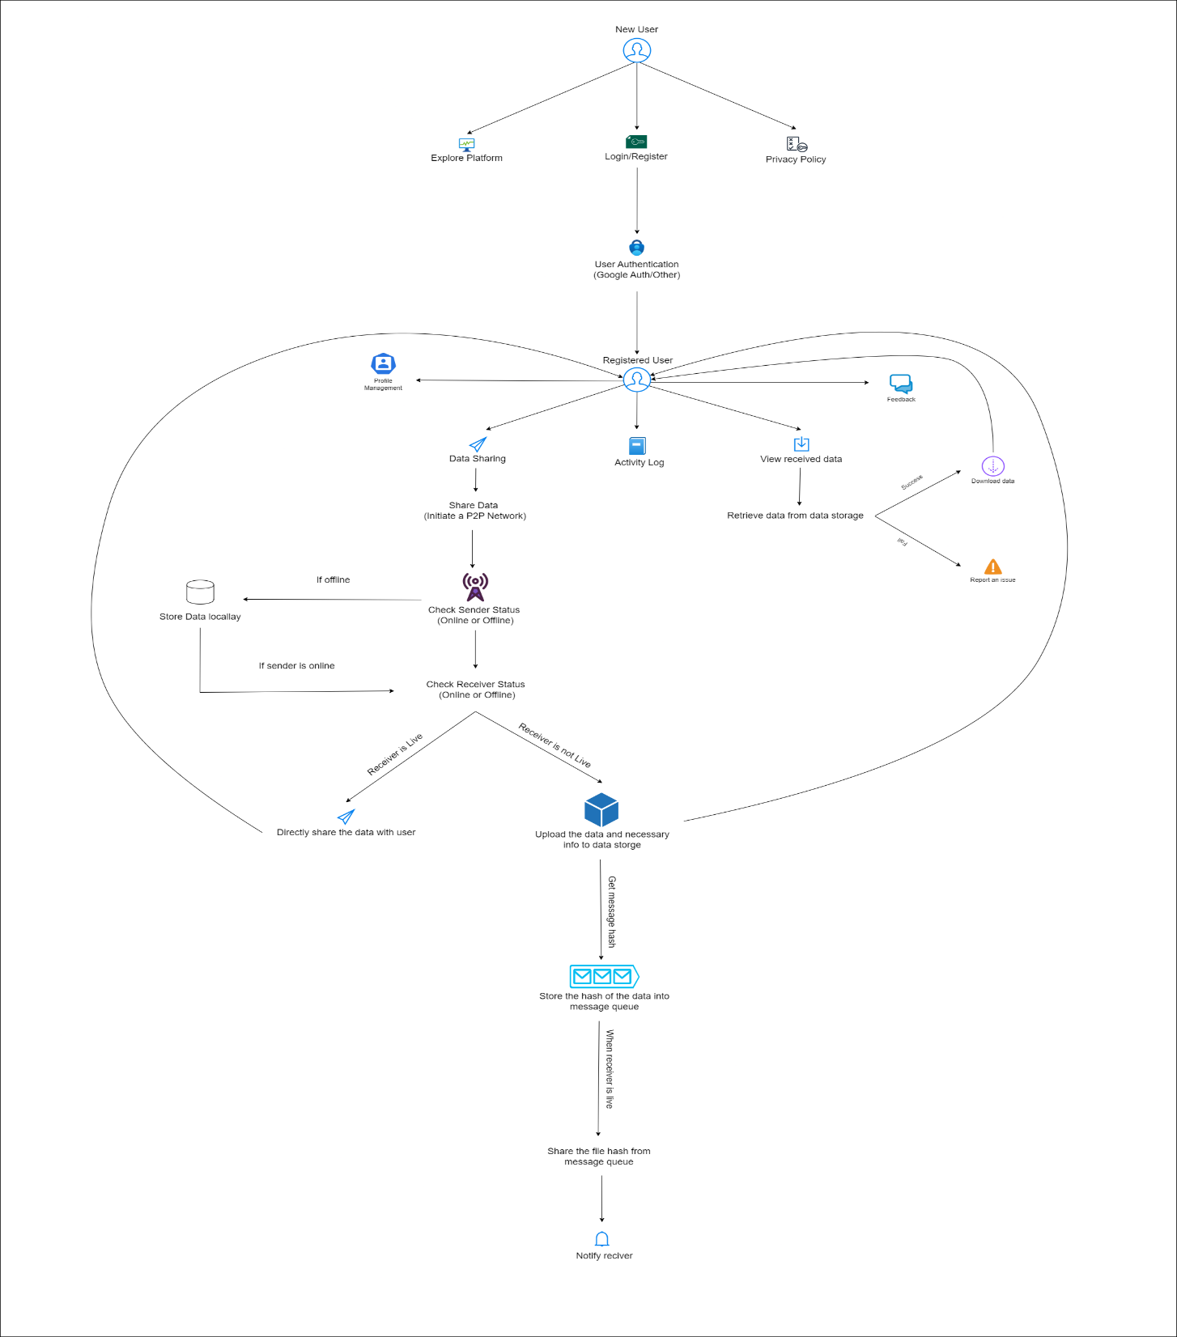

Slide 13
Class Diagram

Slide 14
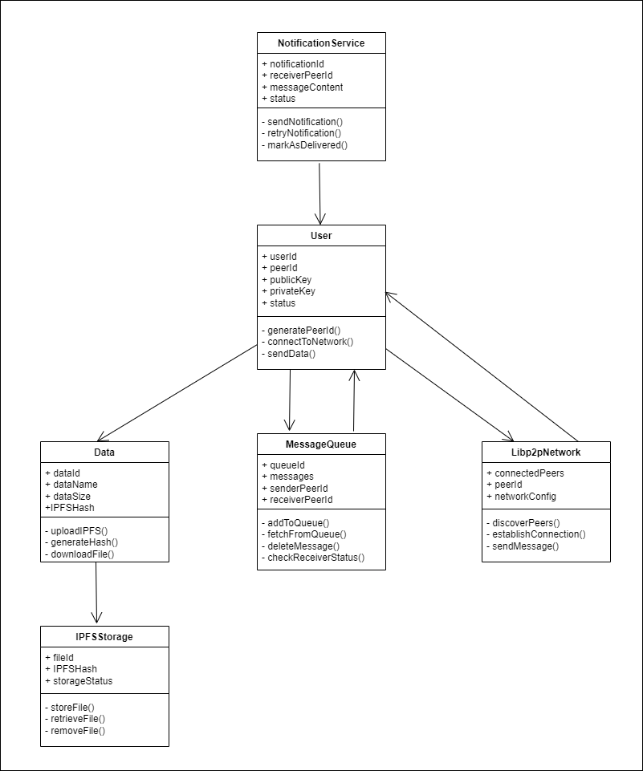

Slide 15
Object Diagram

Slide 16
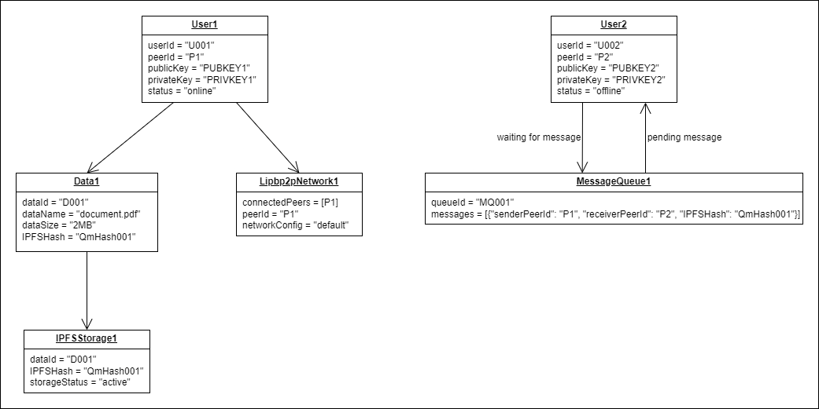

Slide 17
Use Case Diagram

Slide 18
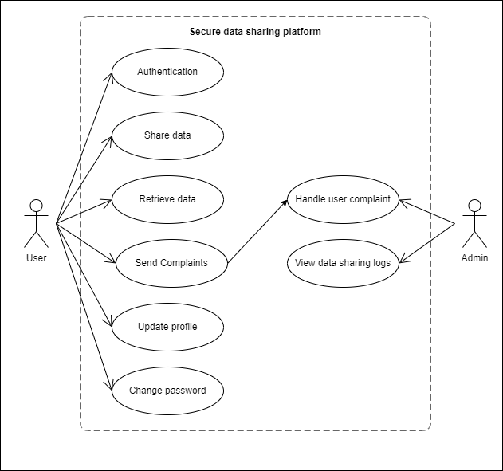

Slide 19
Sequence Diagram

Slide 20
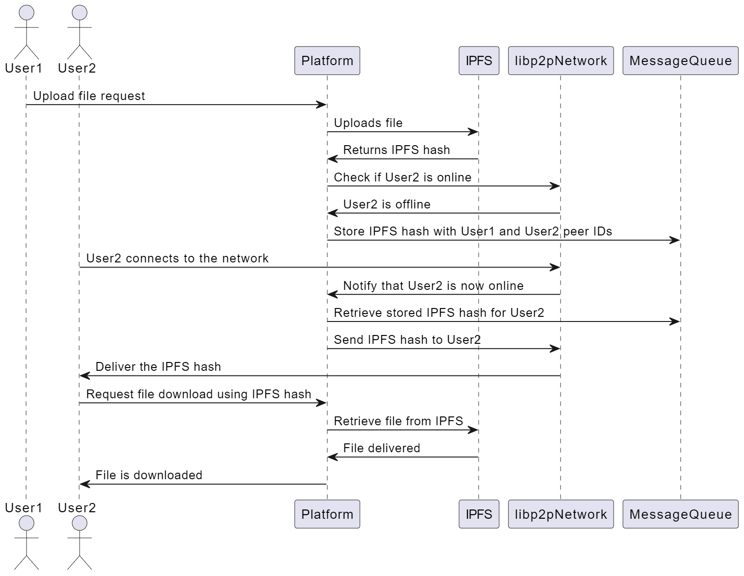

Slide 21
Activity Diagram

Slide 22
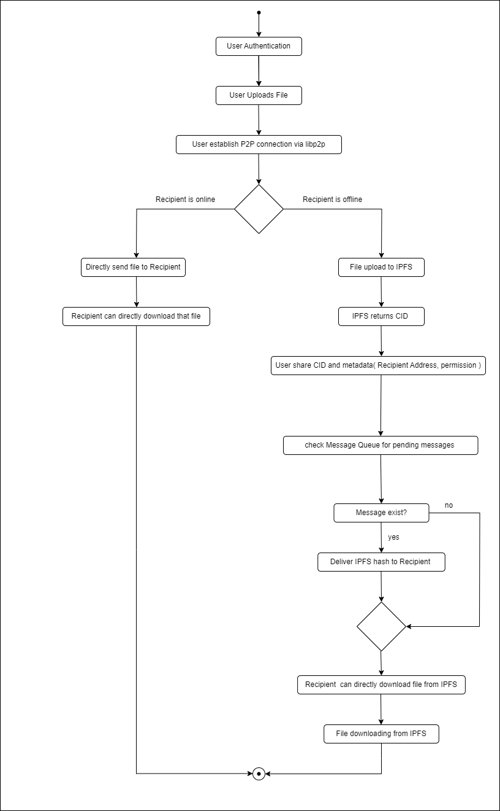

Slide 23
Conclusion
BlockShare aims to improve data privacy, control and security in file-sharing by using IPFS and peer-to-peer networks instead of centralized servers. By addressing common challenges like data breaches and third-party control, BlockShare builds trust among users, ensuring that personal and business files are shared securely. Users can verify file authenticity and track sharing history through activity logging, enhancing transparency and reliability. Ultimately, BlockShare supports a shift towards a more secure, user-centered filesharing ecosystem. It enables individuals and businesses alike to manage their digital exchanges with confidence, ensuring that their data remains private, protected, and under their control.

Slide 24
References
Thong Hoang Dilum Bandara Qin Wang Qinghua Lu Xiwei Xu Liming Zhu Petar Popovski Linh T. Nguyen, Lam Duc Nguyen and Shiping Chen. Blockchain empowered trust worthy data sharing: Fundamentals, applications, and challenges. NA., 1:40, 2023.
Yi Lu, Weichao Wang, Bharat Bhargava, and Dongyan Xu. Trust-based privacy preservation for peer-to-peer data sharing. IEEE Transactions, 36:498–502, 2006.
Al-Zahrani Fahad Ahmad. Subscription-based data-sharing model using blockchain and data as a service. IEEE Access, 8:115966–115981, 2020.
Jianping Tu Qimei Jiang Xianggui Yang Pengyong Cao, Guijiang Duan and Chen Li. Blockchain based process quality data sharing platform for aviation suppliers. IEEE Access, 11:19007–19023, 2024.
Vikas Jaiman and Visara Urovi. A consent model for blockchain-based health data sharing platforms. IEEE Access, 8(1):143734–143745, 2020.
Rui Song, Bin Xiao, Yubo Song, Songtao Guo, and Yuanyuan Yang. A survey of blockchain-based schemes for data sharing and exchange. IEEE Transactions on Big Data, 9:1477–1495, 2023.
Min Yang and Yuanyuan Yang. Applying network coding to peer-to-peer file sharing. IEEE Transactions, 63:1938–1950, 2014.

Slide 25
Thank You

